Slide 1
Robust Regression
V & R: Section 6.5
Denise Hum . Leila Saberi . Mi Lam

Slide 2
Linear Regression
From Ott & Longnecker
Use data to fit a prediction line that relates a dependent variable y and a single independent variable x. That is, we want to write y as a linear function of x: y = β₀ + β₁x + ε
Assumptions of regression analysis
1. The relation is linear so that the errors all have expected value zero; E(ε_{i}) = 0 for all i
2. The errors all have the same variance: Var(ε_{i}) = σ²_{ε} for all i
3. The errors are independent of each other.
4. The errors are all normally distributed: ε_{i} is normally distributed for all i.

Slide 3
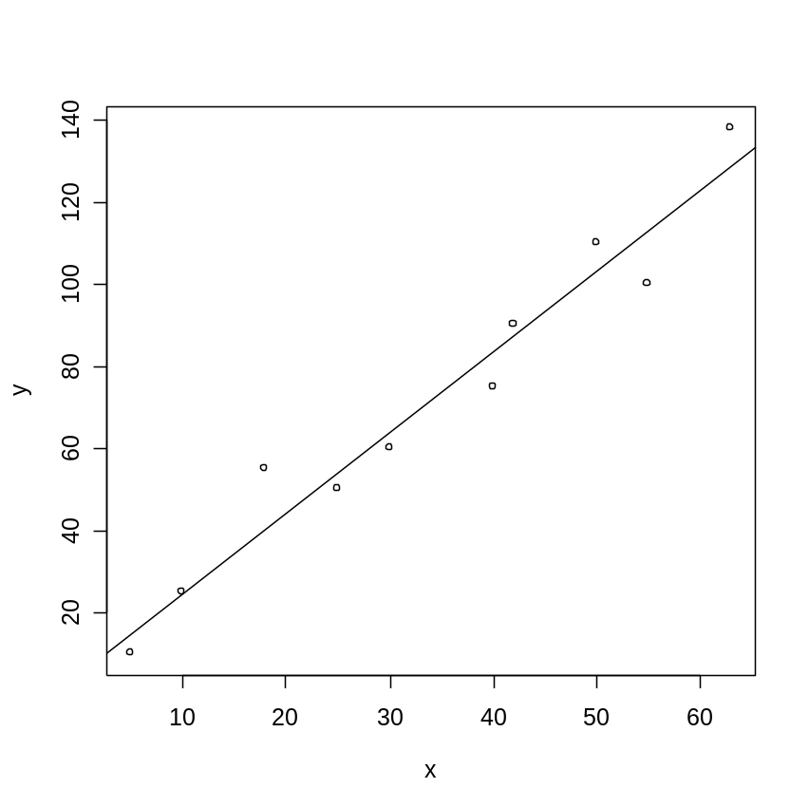
Example – Least squares method works well
Data from Ott & Longnecker Ch. 11 exercise
lm(formula = y ~ x)
Coefficients:
Estimate Std. Error t value Pr(>|t|)
(Intercept) 4.6979 5.9520 0.789 0.453
x 1.9705 0.1545 12.750 1.35e-06 ***
Residual standard error: 9.022 on 8 degrees of freedom
Multiple R-Squared: 0.9531, Adjusted R-squared: 0.9472
F-statistic: 162.6 on 1 and 8 DF, p-value: 1.349e-06

Slide 4
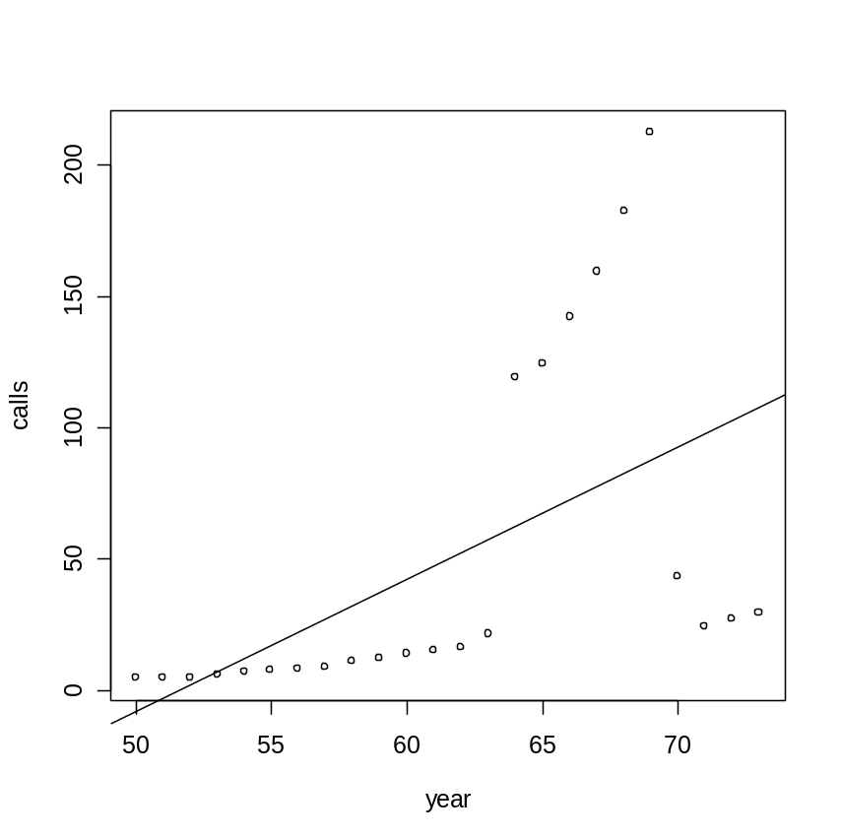
But what happens if your data has outliers and/or fails to meet the regression analysis assumptions?
Data: phones data set in the MASS library.
This data represents the number of phone calls in millions in Belgium between 1950 and 1973. However, between 1964 and 1969 the total length of calls (in minutes) were recorded rather than the number, and both recording systems were used during parts of 1963 and 1970.

Slide 5
Outliers
Outliers can cause the estimate of the regression slope line to change drastically. In the least squares approach we measure the response values in relation to the mean. However, the mean is very sensitive to outliers – one outlier can change it’s value so it has a breakdown point of 0%. On the other hand, the median is not as sensitive – it is resistant to gross errors and has a 50% breakdown point. So if the data is not normal, the mean may not be the best measure of central tendency. Another option with a higher breakdown point is the trimmed mean.

Slide 6
Why can’t we just delete the suspected outliers?
Users don’t always screen the data.
Rejecting outliers affects the distribution theory, which ought to be adjusted. In particular, variances will be underestimated from the “cleaned” data.
The sharp decision to keep or reject an oberservation is wasteful. We can do better by down-weighting extreme observations rather than rejecting them, although we may wish to reject the completely wrong observations.
So try robust or resistant regression

Slide 7
What are robust and resistant regression?
Robust and resistant regression analyses provide alternatives to a least squares model when the data violates the fundamental assumptions.
Robust and resistant regression procedures dampen the influence of outliers, as compared to regular least squares estimation, in an effort to provide a better fit for the majority of data.
In the V&R book, robustness refers to being immune to assumption violations while resistance refers to being immune to outliers.
Robust regression, which uses M-estimators, is not very resistant to outliers in most cases.

Slide 8
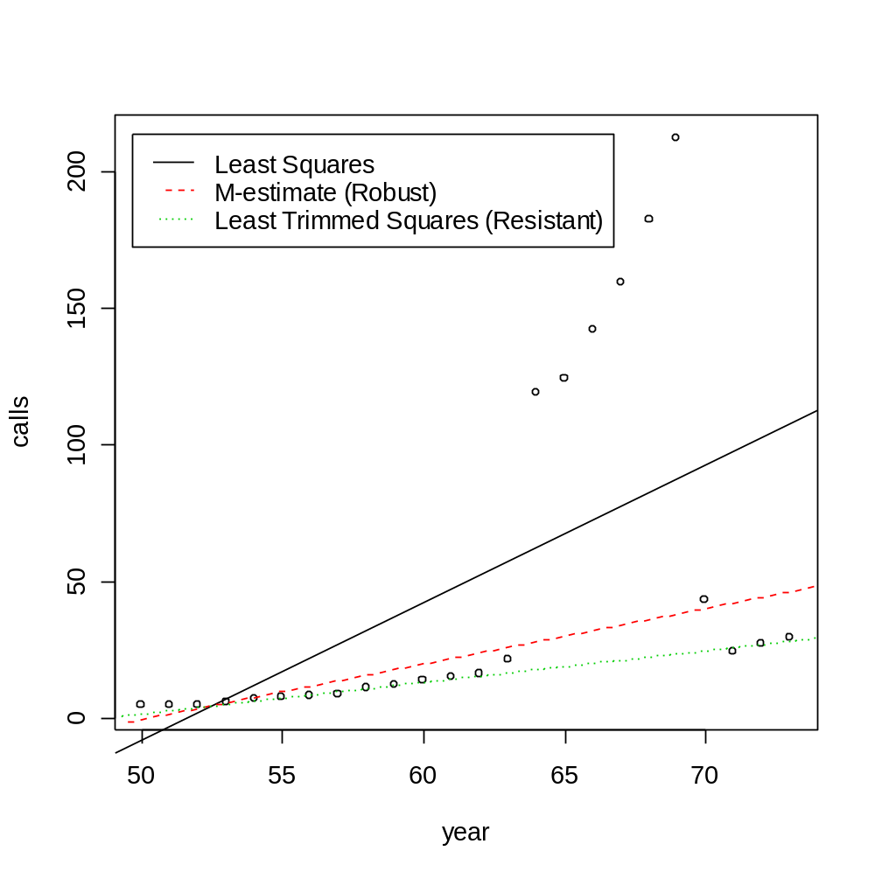
Phones data with Least Squares, Robust, and Resistant regression lines

Slide 9
Contrasting Three Regression Methods
Least Square Linear Model
Robust Methods
Resistant Methods

Slide 10
Least Square Linear Model
Is the traditional Linear Model Regression
Determines the best fitting line as the line that minimizes Sum of Square of Errors.
SSE=Σ(Y_{i} - Y_{i}-hat)
If all the assumptions are met, this is the best linear unbiased estimate. (blue)
Less complex in terms of computations, but very sensitive to outliers.

Slide 11
Robust Regression
Is an alternative to Least Square method when errors are non-normal.
Uses iterative methods to assign different weights to residuals until the estimation process converges.
Useful to detect outliers by finding cases whose final weights are relatively small.
Can be used to confirm the appropriateness of the ordinary least square model.
Primarily helpful in finding cases that are outlying with respect to their y values (long-tailed errors). They can’t overcome problems due to variance structure.
More complex to evaluate the precision of the regression coefficients, compared to ordinary model.

Slide 12
One robust method(V&Rp.158)
M-estimators
Assume f is a scaled pdf, set ρ = - log f, the maximum likelihood estimator minimizes the following to find the β’s:
Σ ρ(y_{i}-x_{i}b)/s + n log s
s is the scale, and it should be determined

Slide 13
Resistant Regression
Unlike Robust Regression, it’s model-based. The answer is always the same.
Rejects all possible outliers.
Useful to detect outlier
Requires much more computing than least squares
Inefficient, only taking into account a portion of the data
Compared to robust methods, they are more resistant to outliers.
Two common types:
Least Median of Squares (LMS)
Least Trimmed Squares (LTS) l

Slide 14
LMS method(V&Rp.159)
Minimize the median of the squared residuals
min median_{i} |y_{i} − x_{i}b|^2
Replaces the sum in Least Square Model method with median.
Very inefficient.
Not Recommended for small samples, due to high breakdown point.

Slide 15
LTS method(V&Rp.159)
Minimize the sum of squares for the smallest q of the residuals.
More efficient compared to LMS, but same resistance to errors
The recommended q is: q=(n+p+1)/2
min Σ |y_{i} − x_{i}b|²_{(i)}

Slide 16
Robust Regression
Began developing techniques in 1960s
Fitting is done by iterated re-weighted least squares (IWLS)
IWLS (IRLS) uses weights based on how far outlying a case is, as measured by the residual for that case.
Weights vary inversely with size of the residual
Continue iteration until process converges
R Code:
RLM() = robust linear model
summary(rlm(calls ~ year, data = phones, maxit = 50), cor = F)
Call: rlm(formula = calls ~ year, data = phones, maxit = 50)
Residuals:
Min 1Q Median 3Q Max
-18.314 -5.953 -1.681 26.460 173.769
Coefficients:
Value Std. Error t value
(Intercept) -102.6222 26.6082 -3.8568
year 2.0414 0.4299 4.7480
Residual standard error: 9.032 on 22 degrees of freedom

Slide 17
Weight Functions for Robust Regression:
(Linear Regression book citation)
Huber’s M estimator (default in R) is used with tuning parameter c = 1.345
w = ψ = { 1 , |u| ≤ 1.345 }
{ (1.345/ |u| ) , |u| >1.345 }
u denotes the scaled residual and is estimated using the median absolute deviation (MAD) estimator (instead of sqrt(MSE))
MAD = (1/.6745)*median { | e_{i} - median{e_{i} }| }
So u_{i} = e_{i} /MAD
Bisquare (redescending estimator)
w = ψ = { [1 – (u / 4.685)² ]² , |u| ≤ 4.685 }
{ 0 , |u| > 4.685 }

Slide 18
R output for 3 different linear models
(LM, RLM with Huber and Bisquare):
summary(lm(calls ~ year, data = phones), cor = F)
Coefficients:
Estimate Std. Error t value Pr(>|t|)
(Intercept) -260.059 102.607 -2.535 0.0189
year 5.041 1.658 3.041 0.0060
Residual standard error: 56.22 on 22 degrees of freedom
summary(rlm(calls ~ year, data = phones, maxit = 50), cor = F)
Coefficients:
Value Std. Error t value
(Intercept) -102.6222 26.6082 -3.8568
year 2.0414 0.4299 4.7480
Residual standard error: 9.032 on 22 degrees of freedom
summary(rlm(calls ~ year, data = phones, psi = psi.bisquare), cor = F)
Coefficients:
Value Std. Error t value
(Intercept) -52.3025 2.7530 -18.9985
year 1.0980 0.0445 24.6846
Residual standard error: 1.654 on 22 degrees of freedom

Slide 19
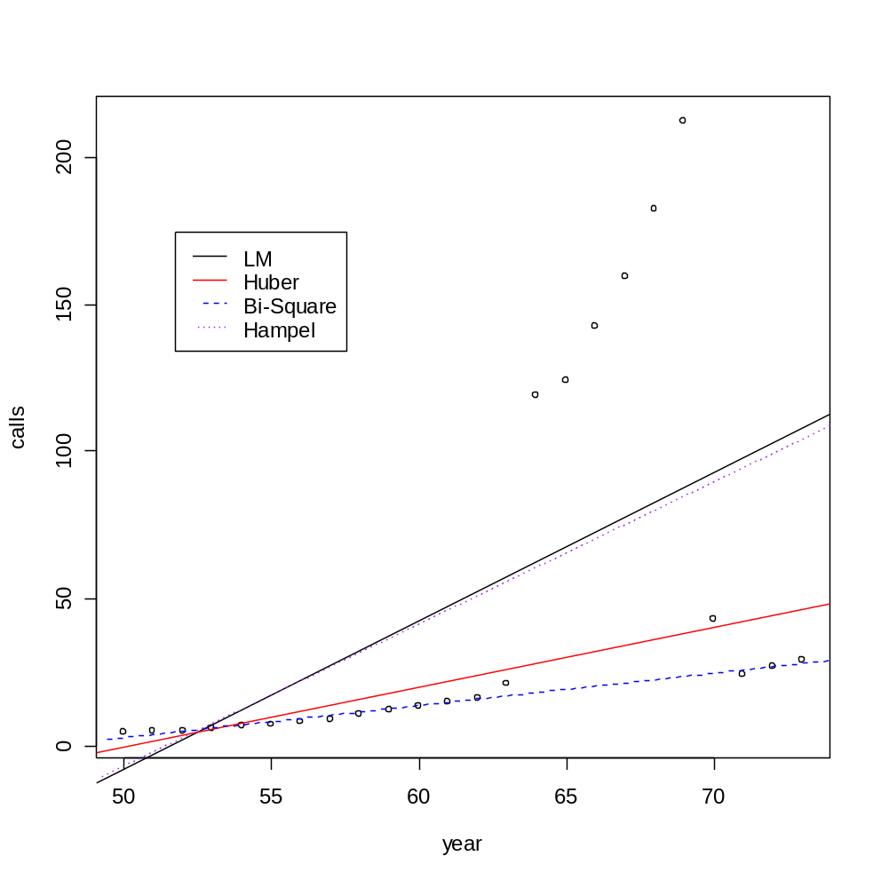
Comparison of Robust Weights using R
attach(phones); plot(year, calls); detach();
abline(lm(calls ~ year, data = phones), lty = 1,col = 'black')
abline(rlm(calls ~ year, phones, maxit=50), lty = 1, col = 'red') #default
abline(rlm(calls ~ year, phones, psi=psi.bisquare, maxit=50), lty = 2, col = blue')
abline(rlm(calls ~ year, phones, psi=psi.hampel, maxit=50), lty = 3, col = purple')
legend(locator(1), lty = c(1,1,2,3), col = c('black','red','blue','purple'),
legend = c("LM","Huber", "Bi-Square", "Hampel"))

Slide 20
Resistant Regression
More estimators developed in 1980s designed to be more resistant to outliers
The goal is to fit a regression to the good points in dataset thereby achieving a regression estimator with a high breakdown point
Least Mean Squares (LMS) and Least Trimmed Squares (LTS)
Both are efficient, but both very resistant
S-estimation (see p. 160)
More efficient than LMS and LTS when data is normal
MM-estimation (combination of M-estimation and resistant regression techniques)
MM-estimator is an M-estimate starting at the coefficients given by the S-estimator and with fixed scaled given by the S-estimator
R Code: LQS()
lqs(calls ~ year, data = phones) # default LTS method
Coefficients:
(Intercept) year
-56.162 1.159
Scale estimates 1.249 1.131

Slide 21
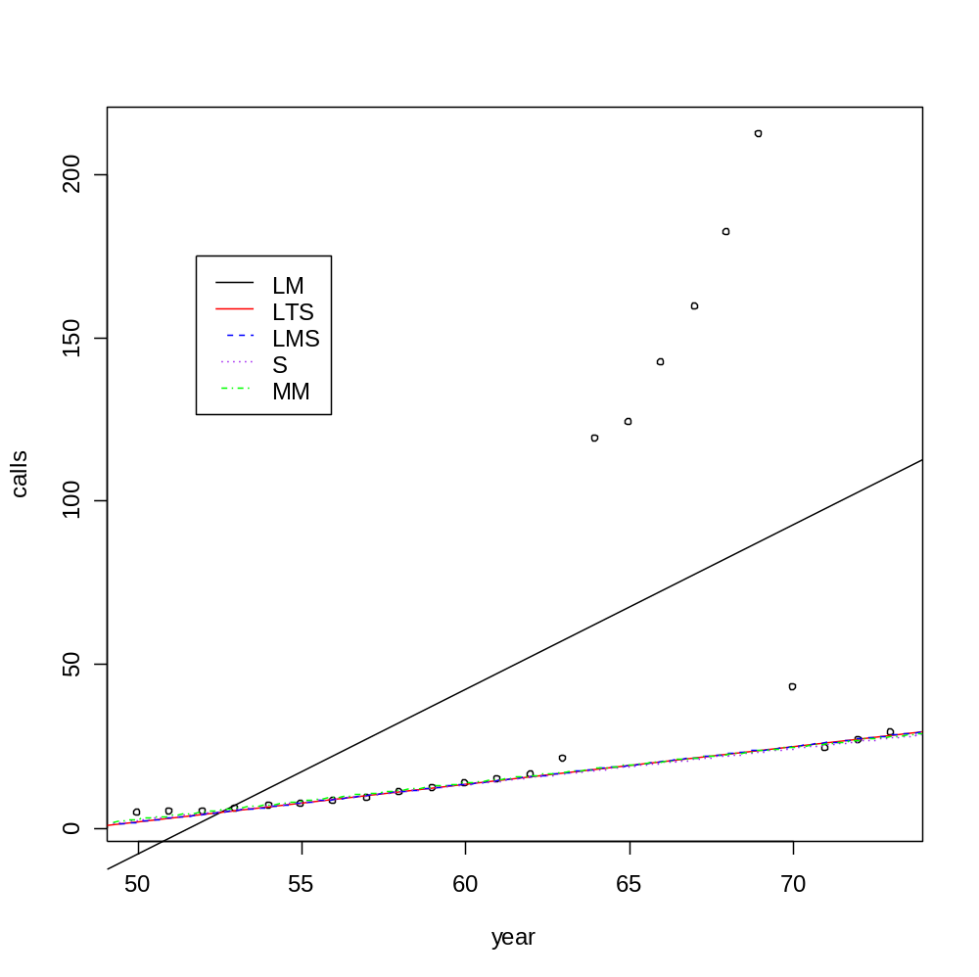
Comparison of Resistant Estimators using R:
attach(phones); plot(year, calls); detach();
abline(lm(calls ~ year, data = phones), lty = 1,col = 'black')
abline(lqs(calls ~ year, data = phones), lty = 1, col = 'red')
abline(lqs(calls ~ year, data = phones, method = "lms"), lty = 2, col = 'blue')
abline(lqs(calls ~ year, data = phones, method = "S"), lty = 3, col = 'purple')
abline(rlm(calls ~ year, data = phones, method = "MM"), lty = 4, col = 'green')
legend(locator(1), lty = c(1,1,2,3,4), col = c('black', 'red', 'blue', 'purple', 'green'), legend = c("LM","LTS", "LMS", "S", "MM"))

Slide 22
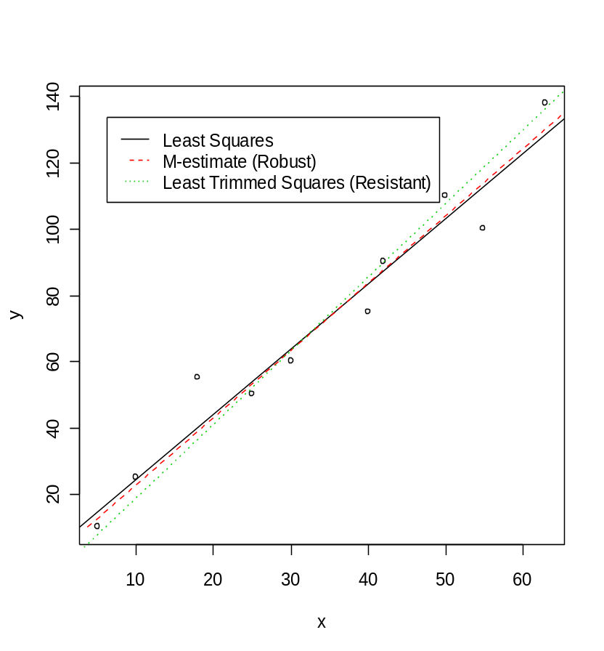
Summary
Some reasons for using robust regression
Protect against influential outliers
Useful for detecting outliers
Check results against a least squares fit
plot(x, y)
abline(lm(y ~ x), lty = 1, col = 1)
abline(rlm(y ~ x), lty = 2, col = 2)
abline(lqs(y ~ x), lty = 3, col = 3)
legend(locator(1), lty = 1:3, col = 1:3,
legend = c("Least Squares", "M-estimate (Robust)", "Least Trimmed Squares (Resistant)"))
To use robust regression in R: function rlm()
To use resistant regression in R: function lqs()

